Slide 1
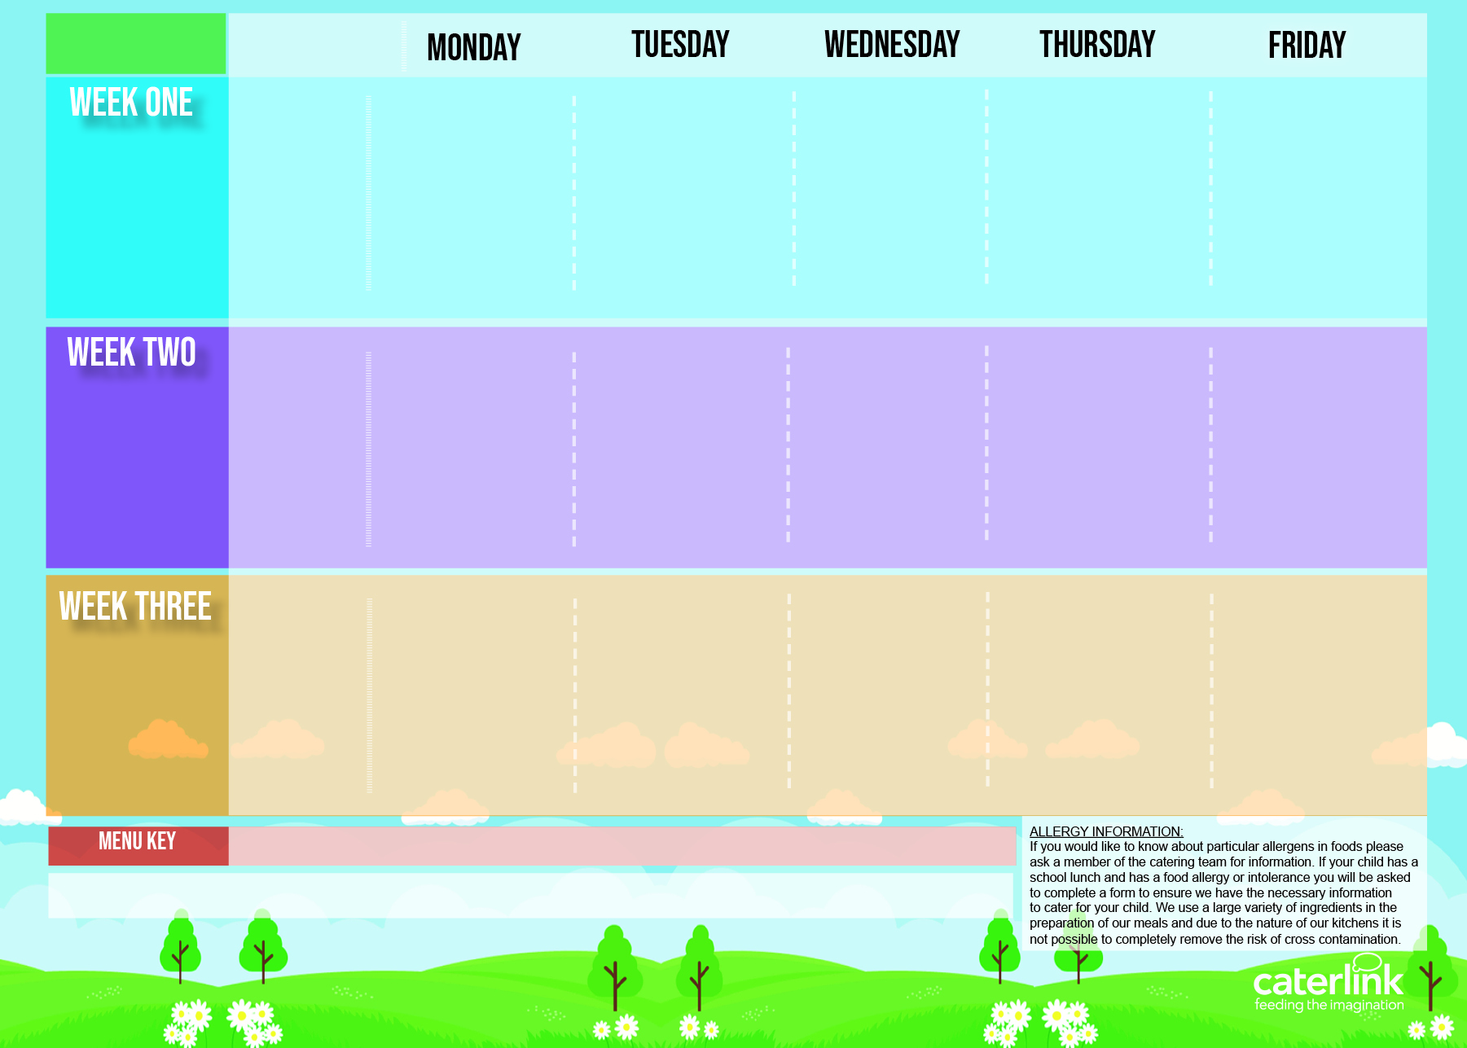
Autumn Winter Menu 2024/25
Option One
Option Two
Vegetables
Dessert
NEW Tomato & Vegetable Pasta | Cottage Pie with Gravy | Peri Peri or BBQ Chicken or Quorn with Diced Seasoned Potatoes & Sweetcorn Salsa | Meatballs in Tomato Sauce with Rice | Salmon Fishfingers/ Fishfingers with Chips & Tomato Sauce
Mexican Fajitas with Rice | NEW Creamy Chickpea and Coconut Curry with Rice |  | NEW Cheese and Broccoli Pasta with Garlic Bread | Mexican Bean Roll with Chips & Tomato Sauce
Vegetables of the Day | Vegetables of the Day | Vegetables of the Day | Vegetables of the Day | Vegetables of the Day
Blackberry and Apple Crumble with Custard | Melting Moment Biscuit | Fruit Platter | Carrot and Courgette Cake | Chocolate Orange Cookie
04/11/2024
25/11/2024
16/12/2024
20/01/2025
10/02/2025
10/03/2025
31/03/2025
Option One
Option Two
Vegetables
Dessert
Classic Cheese and Tomato Pizza Or Rainbow Pizza With Potato Wedges | NEW Chicken Pasta Bake with Garlic Bread | Prok Sausage and Mash with Gravy | Chicken Tikka Masala with Rice | NEW Tuna Pasta Bake or Fishfingers with Chips & Tomato Sauce
 | Chinese Vegetable Curry with Rice | Vegan Sausage and Mash with Gravy | NEW Mild Mexican Chilli with Rice | Cheese and Tomato Quiche with Chips & Tomato Sauce
Vegetables of the Day | Vegetables of the Day | Vegetables of the Day | Vegetables of the Day | Vegetables of the Day
Marble Sponge Cake with Custard | Jelly with Mandarins | Fruit Medley | Peach Cake | Oaty Cookie
11/11/2024
02/12/2024
06/01/2025
27/01/2025
24/02/2025
17/03/2025
07/04/2025
Option One
Option Two
Vegetables
Dessert
Macaroni Cheese | NEW Mild Caribbean Chicken with Rice and Peas NEW Caribbean Butterbean Stew with Rice and Peas | Roast Chicken with Stuffing, Roast Potatoes and Gravy | Spaghetti Bolognaise | Breaded Fish with Chips & Tomato Sauce
Plant Balls in Tomato Sauce with Rice |  | Cottage Pie with Gravy | NEW Hot Pot Baked Bean Casserole with Rice | Cheese and Pepper Omelette with Chips & Tomato Sauce
Vegetables of the Day | Vegetables of the Day | Vegetables of the Day | Vegetables of the Day | Vegetables of the Day
Chocolate and Beetroot Brownie | Sticky Toffee Apple Crumble with Custard | Fruit Salad | NEW Savoury Cheese Scone | Vanilla Shortbread
18/11/2024
09/12/2024
13/01/2025
03/02/2025
03/03/2025
24/03/2025
14/04/2025
Added Plant Power
Wholemeal
Vegan
Available Daily: Fresh Bread – Salad Selection – Fresh Fruit and Yoghurt

